Slide 1



Department of Computer Science Engineering
Nayan Nirikshan
Violence Detection System using Surveillance Camera
Language and Image Processing Project
Subhash B S I Harsha R I Nityanand Kumar I Sumanth Hegde
Guide: Prof. Bhagyashri Wakde

Slide 2




Nayan Nirikshan
Advance Violence Detection System using Surveillance Camera

Slide 3
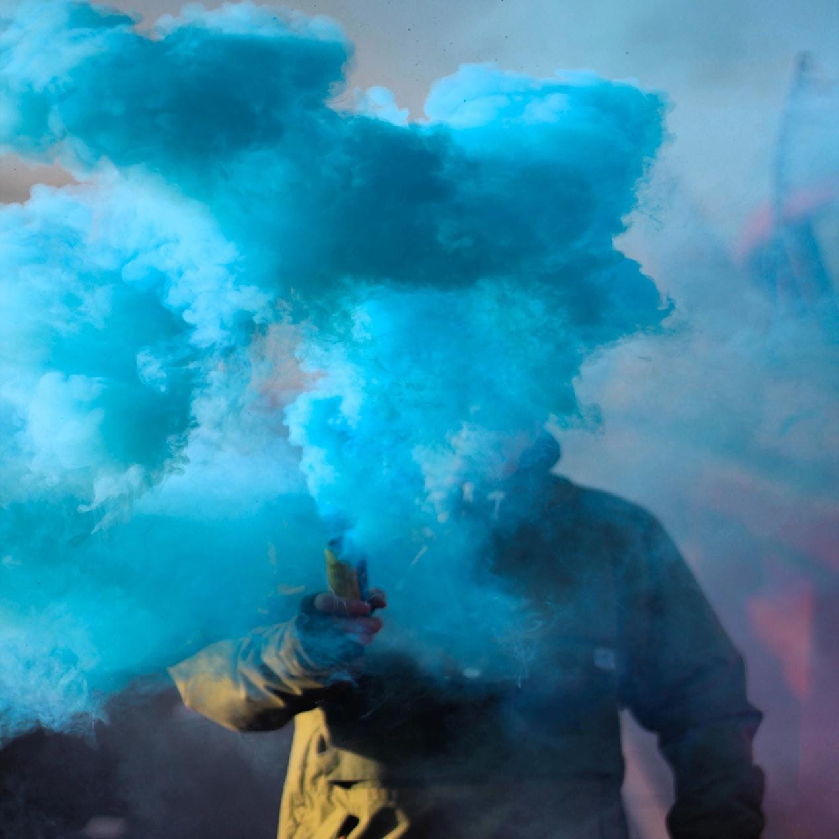
01
Abstract
Info on our project
Introduction
02
Story Time
03
Motivation of Project
Some serious stuff
Literature Survey
04
Random stuff
05
Problem Statement
Problems

Slide 4
06
System Modules
modules
07
Requirement Engineering
Requirements
08
Diagrams
Random stuff
09
Project Planning and Scheduling
Some serious stuff
10
Implementation
Code

Slide 5
Results
11
Snapshots
12
Applications
Uses
13
Conclusion
The End
14
References
Experts
15
Journal Papers
Research

Slide 6
ABSTRACT
B
S
C
T
A
T
R
A
Overview of project work

Slide 7


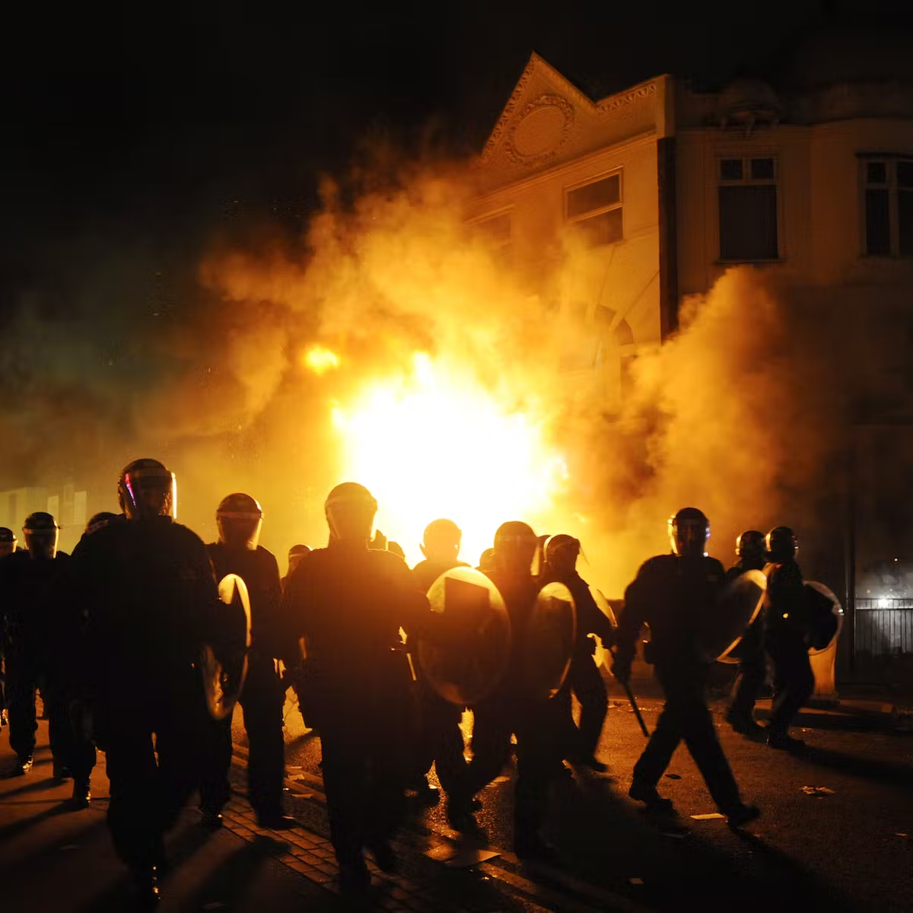
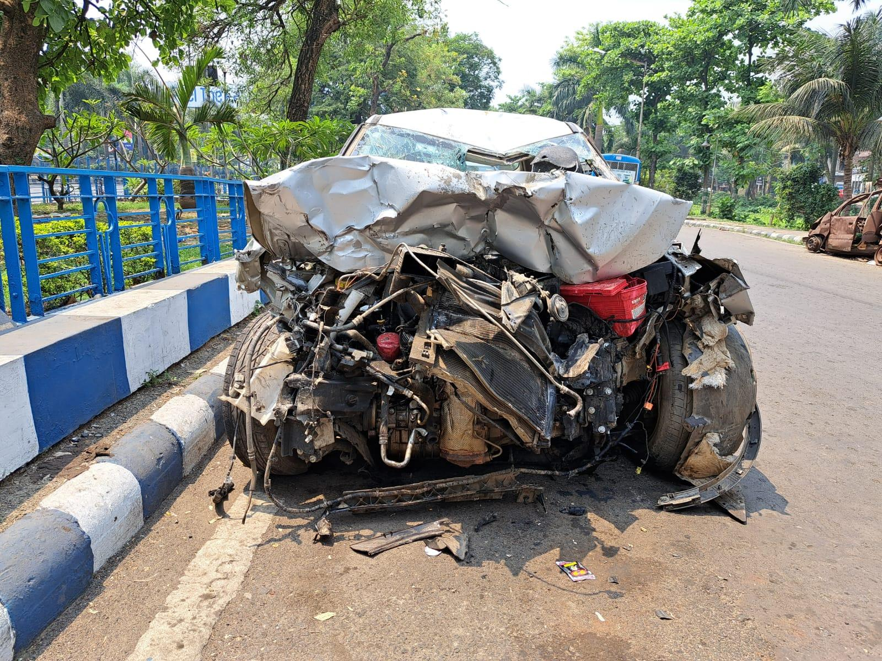
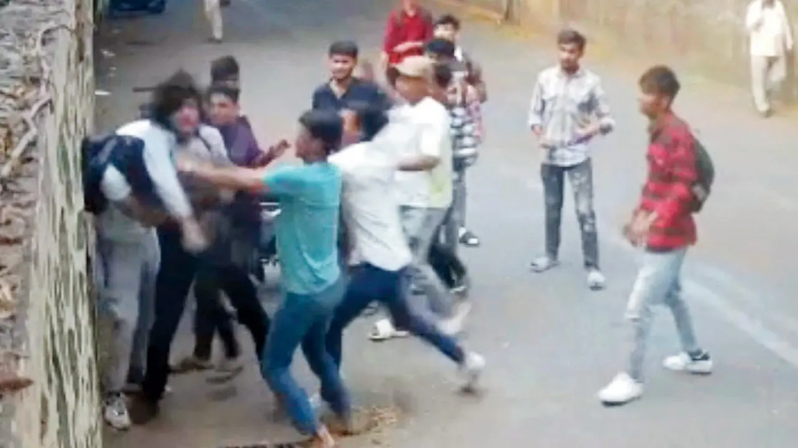


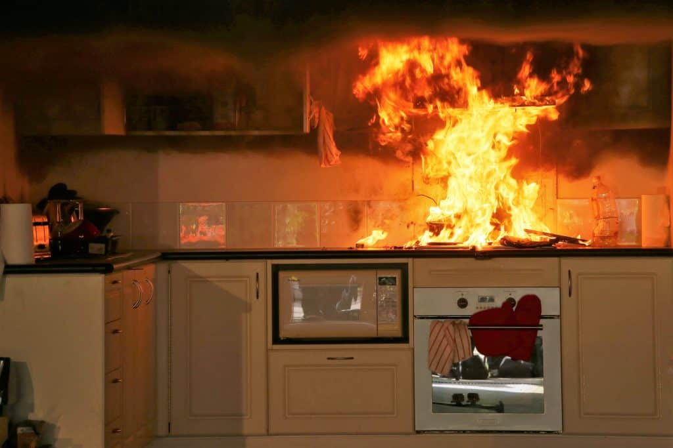
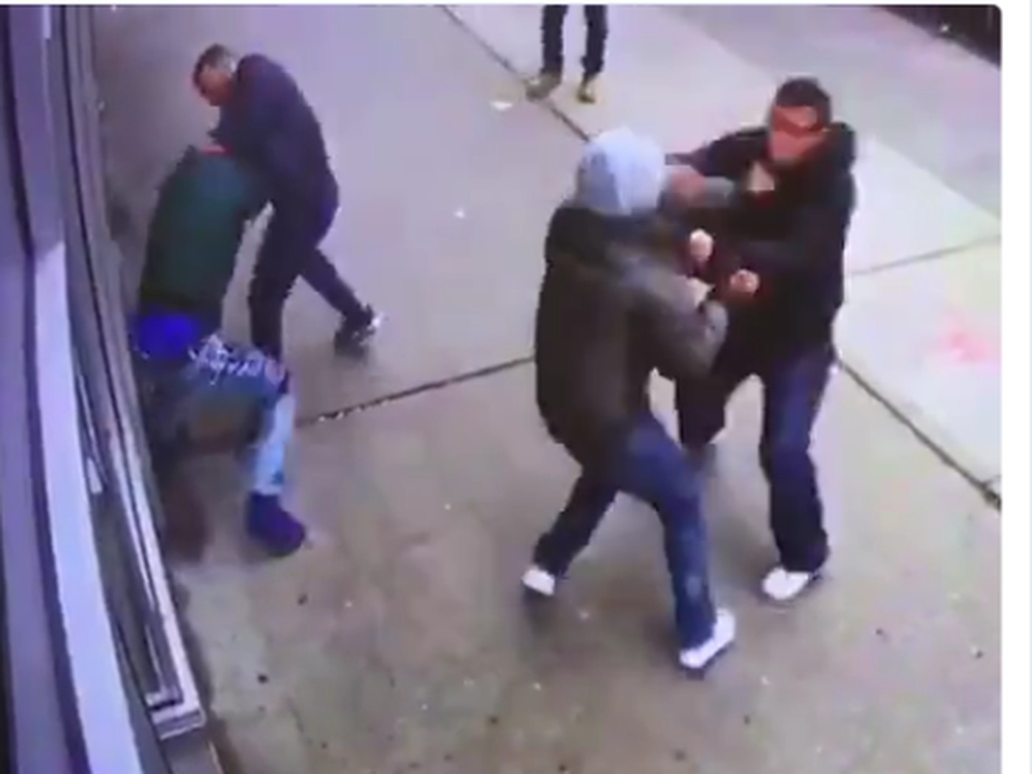


MOTIVATION TO PROJECT
Crash
Ragging
Riots
Street Fight
Fire
Domestic Violence

Slide 8

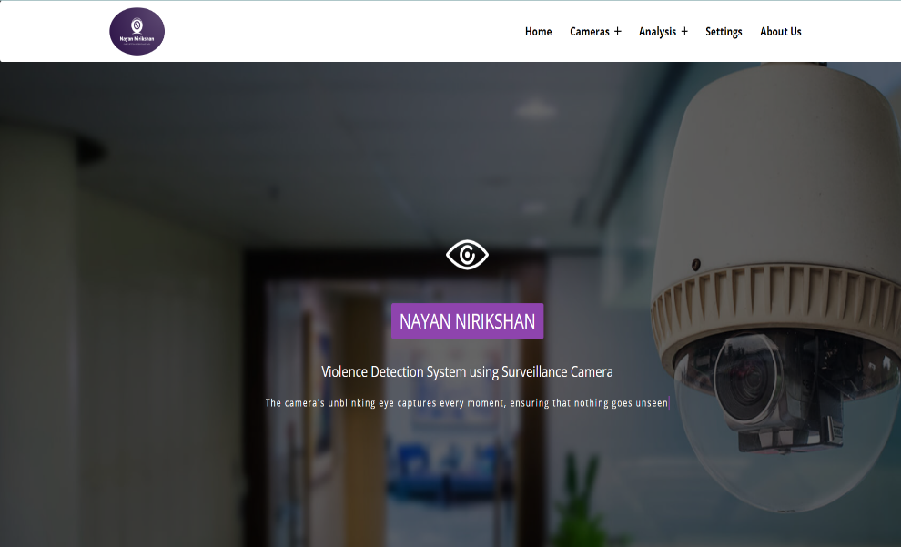
INTRODUCTION

Slide 9
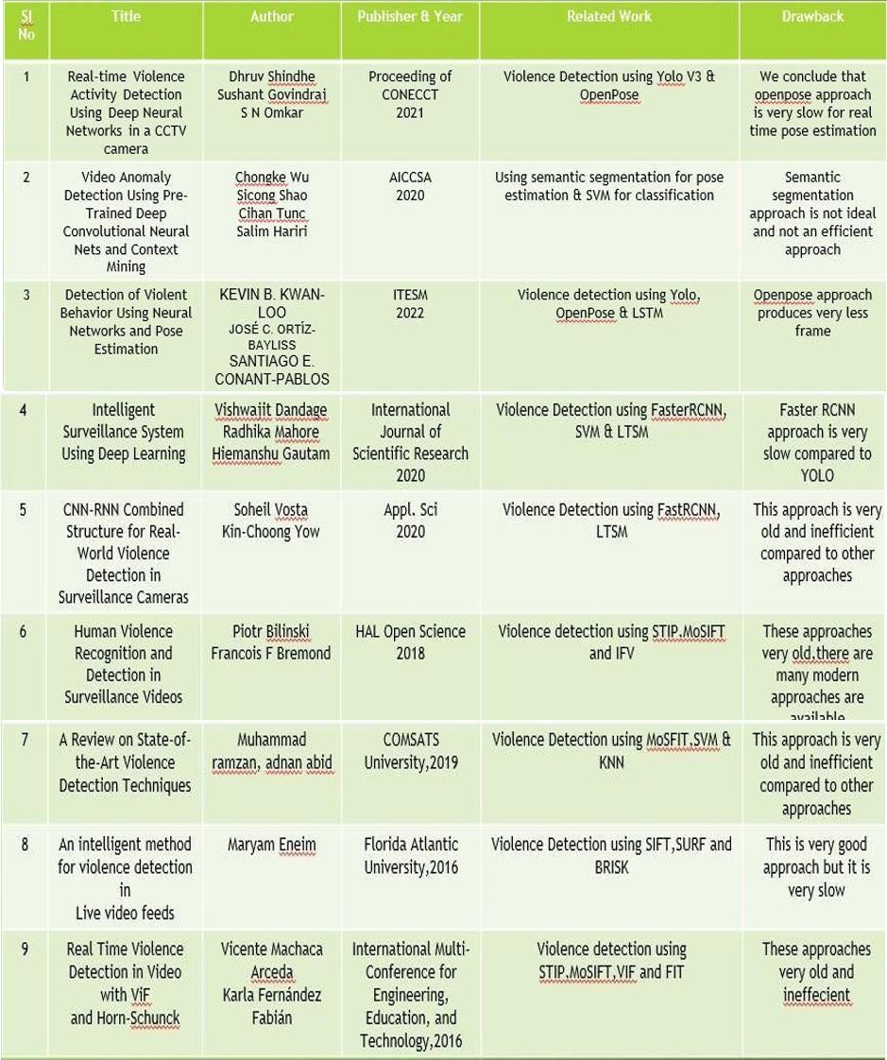
Literature Survey

Slide 10
Drawbacks of Existing System
Privacy concerns
Limited Accuracy
High false positives
Ethical Considerations
Sensitivity to Environmental Factors
Lack of Generalization
Limited
Scalability

Slide 11
NAYAN NIRIKSHAN
Problem statement
Enhancing public safety and security in public spaces.
Improving crowd management and response during events or gatherings.
Automating surveillance systems for efficient violence detection.
Ensuring school safety by detecting and preventing violence.
Assisting law enforcement in identifying and responding to violent actions.
Facilitating real-time video content moderation to maintain online safety.

Slide 12
Proposed System
Our System application is on the Violence Detection and smart alert system using modern technologies like Yolo v8, Movenet and some machine learning classifier such as SVM. We implemented a alert system using Telegram-Bot, it receives an alert message with location and recordings of the incidents taken place.

Slide 13

SYSTEM MODULES
1
DATA PREPARATION
Data Preparation
Collection and preparation of good quality data for Training.
2
Model Training
Training the model using the collected data.
MODEL EVALUATION
MODEL TRAINING
3
Model Evaluation
Evaluation of our trained model for performance analysis.

Slide 14
KEY FEATURES OF SYSTEM
KEY FEATURES OF SYSTEM
Not Limited to Violence
Smart Alert System
Our model's capabilities extend beyond violence detection, allowing for a wide range of potential applications in the realm of public safety and security.
Our model can alert authorized personnel through the messaging app Telegram, allowing for quick and effective response to potential threats.
INTELIGENT
LOW MAINTENANCE
1
4
2
3
# Outside
# Inside
Our model has the ability to detect and classify various outdoor activities, making it a valuable tool for enhancing safety and security in public spaces.
BEST IN MARKET
SECURITY.
Our model has the ability to detect and classify various indoor activities, making it a valuable tool for enhancing safety and security in indoor environments

Slide 15
NAYAN NIRIKSHAN
Requirement Engineering
Software Requirements :
Operating system : Windows / Linux.
• Coding Language : Python, Django, ReactJs
• Software Tool : movenet, OpenCV, Django, ReactJs, Telepot
• Internet access

Slide 16
Hardware Requirement
System : i3 6gen or above.
Hard Disk : 250 GB.
Monitor : 15 VGA Color.
Mouse : Logitech.
RAM : 8 GB
Graphics card : RTX 1650Ti
Surveillance Camera : Wireless, Day/night, Network/IP CCTV cameras

Slide 17
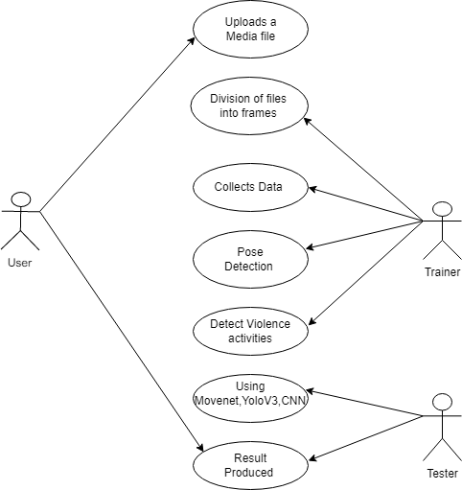

Use case Diagram

Slide 18
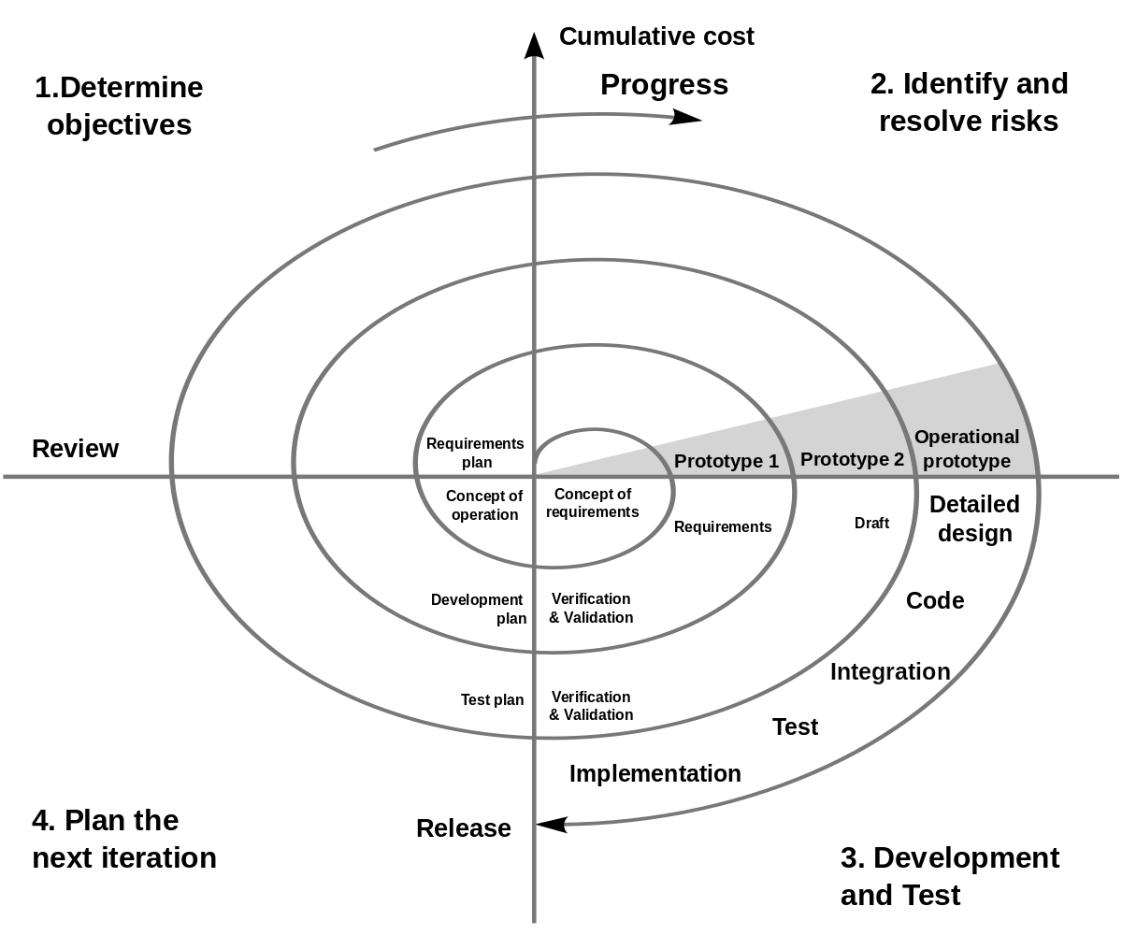
SPIRAL Diagram

Slide 19

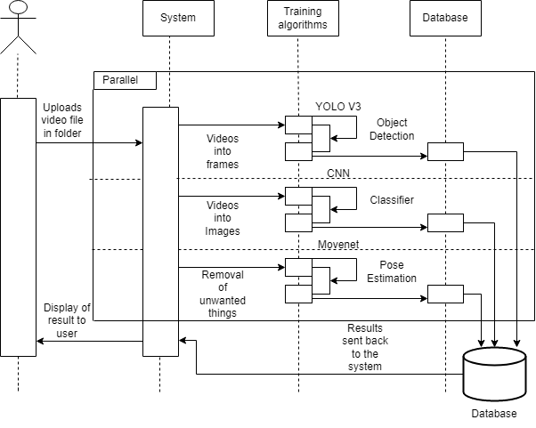
Sequence Diagram.
A.
B.
C.

Slide 20
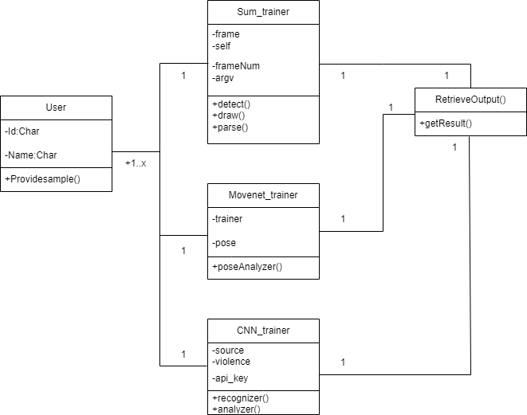
Class Diagram

Slide 21
Project Planning and Scheduling
A.
B.
C.

Slide 22
NAYAN NIRIKSHAN
Implementation
# Image Analysis PAGE ---------------------
def model_eval(request):
context = {}
if request.POST:
MEDIA_ROOT = Settings.MEDIA_ROOT
print(MEDIA_ROOT)
img = request.FILES['img']
img_obj = ImageModel()
img_obj.img = img
img_obj.name = random.randint(10000,1000000)
img_obj.save()
img_name = img_obj.img.url.split('/')[-1]
# print(img_name)
img_path = os.path.join(MEDIA_ROOT,'images',img_name)
# print(img_path)
image = cv2.imread(img_path)
image = cv2.cvtColor(image, cv2.COLOR_BGR2RGB)
predict_img_path = model_predict(image)
context['img_obj'] = img_obj
context['predict_img'] = "image/"+predict_img_path.split('\\')[-1]

Slide 23
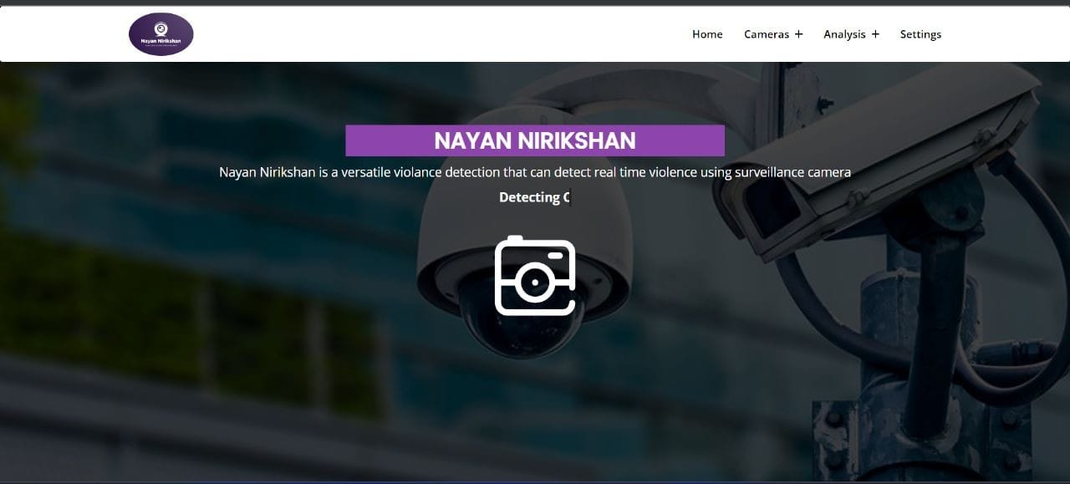
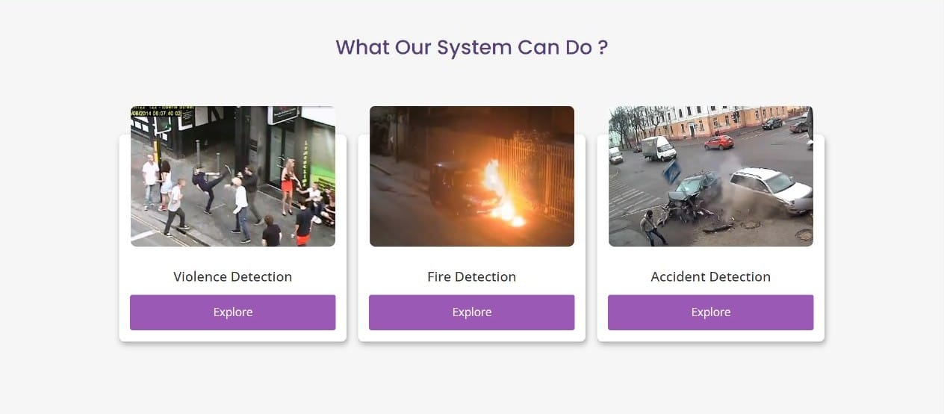
NAYAN NIRIKSHAN
Results
Snapshots :

Slide 24
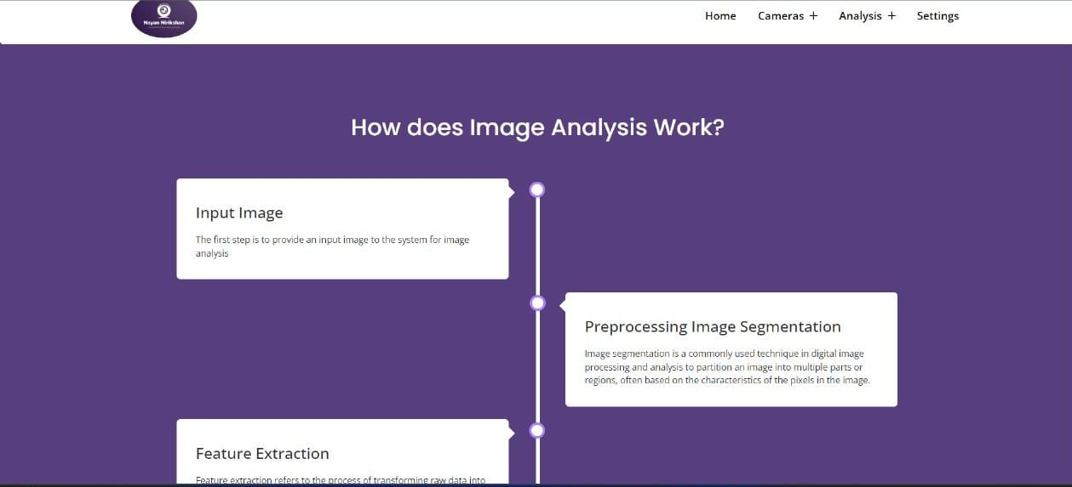
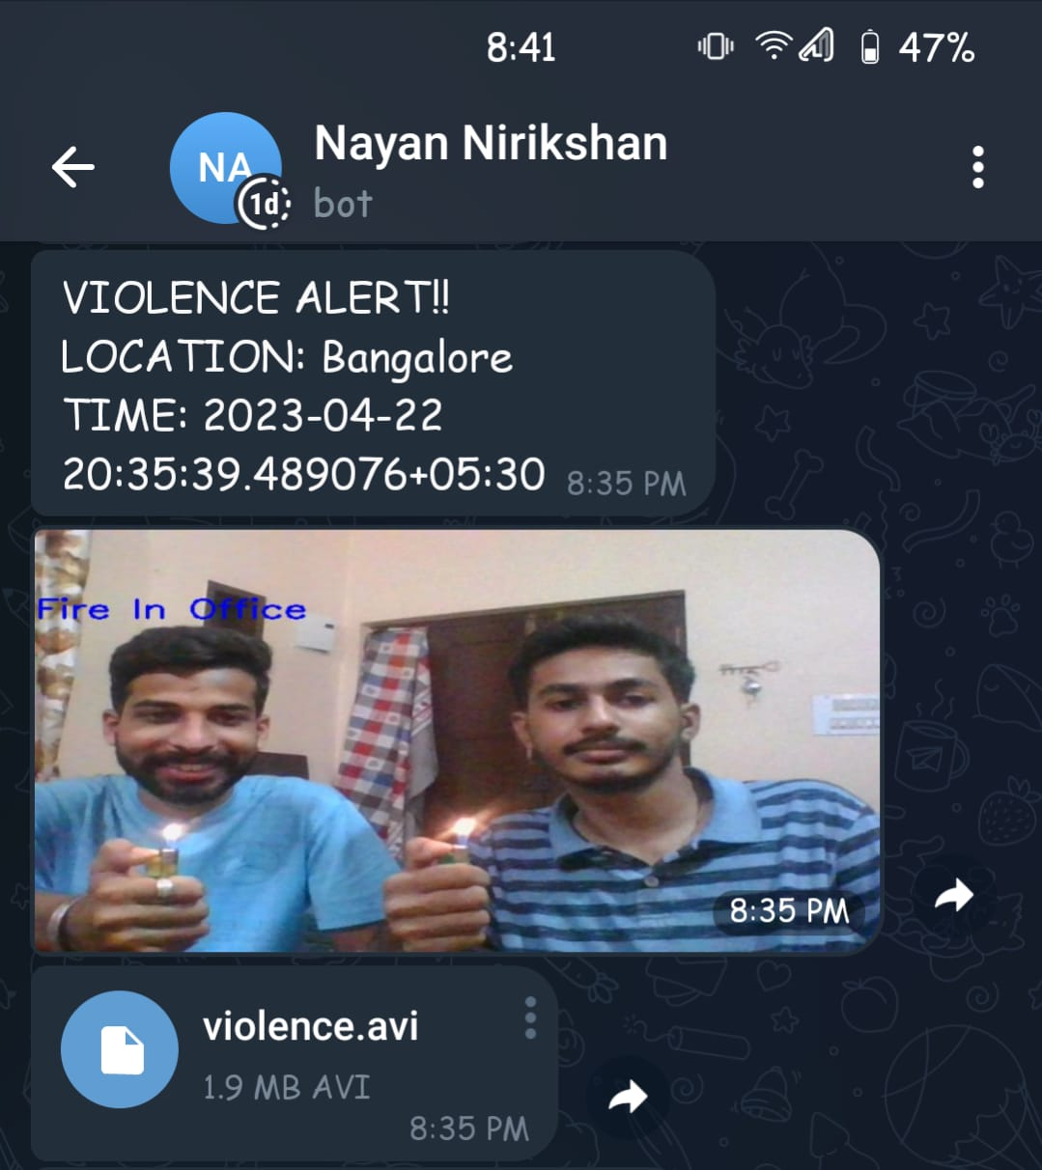
NAYAN NIRIKSHAN

Slide 25
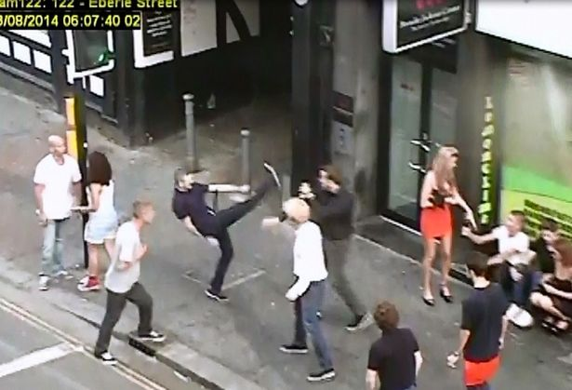
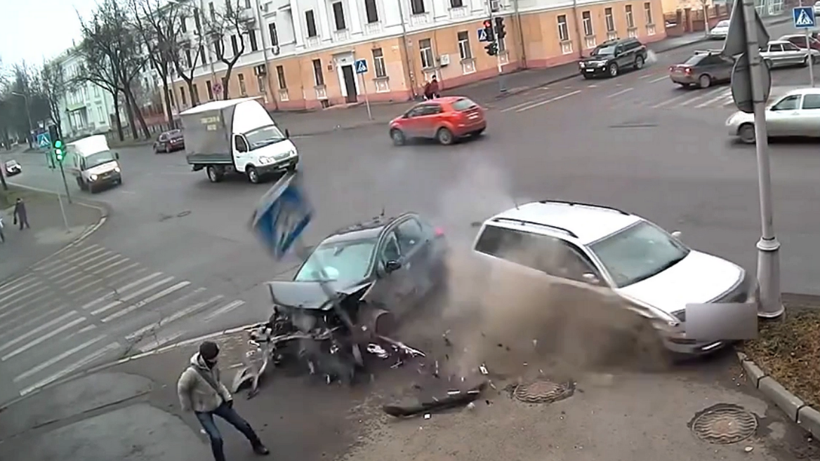
NAYAN NIRIKSHAN

Slide 26
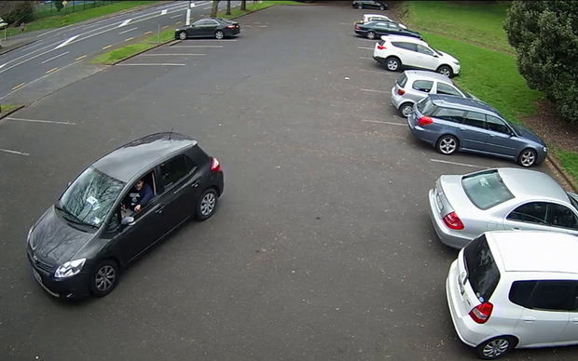
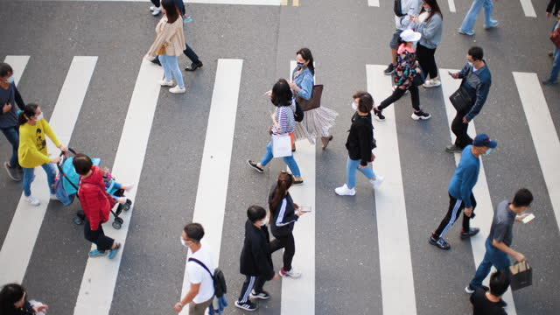
NAYAN NIRIKSHAN

Slide 27
Applications
Public Safety and Security
Law Enforcement Support
Crowd Management
Video Analytics and Forensics
Surveillance Systems
School Safety
Social Media Content
Moderation

Slide 28



CONCLUSION
This project has motivated us to develop a versatile violence detection system using surveillance cameras that can enhance safety and security in public spaces, both indoors and outdoors. Moving forward, we are excited to continue exploring other potential applications of this technology to make a positive impact on the safety of individuals and communities.

Slide 29
References
NAYAN NIRIKSHAN
Y. Wang, J. F. Doherty, and R. E. Van Dyck, “Moving object tracking in video,” in Proceedings - Applied Imagery Pattern Recognition Workshop, 2000, vol. 2000-January, pp. 95–101.
• B. Tian, Q. Yao, Y. Gu, K. Wang, and Y. Li, “Video processing techniques for traffic flow monitoring: A survey,” in IEEE Conference on Intelligent Tranhuman actionation Systems, Proceedings, ITSC, 2011, pp. 1103–1108.
• J. M. B. Oñate, D. J. M. Chipantasi, and N. D. R. V. Erazo, “Tracking objects using Artificial Neural Networks and wireless connection for robotics,” J. Telecommun. Electron. Comput. Eng., vol. 9, no. 1–3, pp. 161–164, 2017.
• M. Brown, J. Funke, S. Erlien, and J. C. Gerdes, “Safe driving envelopes for path tracking in au-tonomous vehicles,” Control Eng. Pract., vol. 61, pp. 307–316, 2017.
• V. A. Laurense, J. Y. Goh, and J. C. Gerdes, “Path-tracking for autonomous vehicles at the limit of friction,” in Proceedings of the American Control Conference, 2017, pp. 5586–5591.
• S. Walker et al., “Systems and methods for localizing, tracking and/or controlling medical in-struments,” 2017.
• M. Buric, M. Pobar, and M. Ivasic-Kos, “An overview of action recognition in videos,” 2017 40th Int. Conv. Inf. Commun. Technol. Electron. Microelectron. MIPRO 2017 - Proc., pp. 1098–1103, 2017.
• P. Viola and M. Jones, “Managing work role performance: Challenges for twenty-first century organizations and their employees.,” Rapid Object Detect. using a Boost. Cascade Simple Fea-tur., 2001.
•

Slide 30
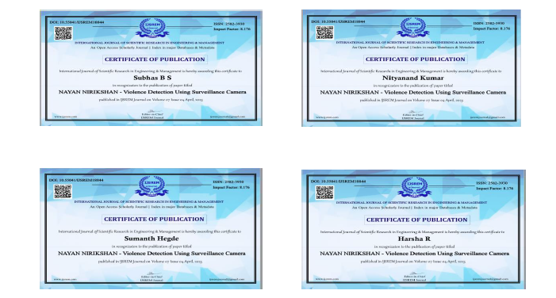
JOURNAL PAPER
Journal Category: Computer Science & Technology
Publication Time: 2-3 weeks
Acceptance Rate: 26%
Publication website: IJSREM
Impact Factor: 8.76
Cite Score: 8.2
Status of Journal: PUBLISHED

Slide 31
The completion of the work.
D
E
M
0
Nayan Nirikshan

Slide 32
NAYAN NIRIKSHAN
Thank you

Slide 33




Q&A
ANY QUESTIONS..?

